Slide 1

Graphics and Computational Programming
James Comer

Slide 2
Features
Spheres, planes, cubes, and cylinders
PBR (or Blinn-Phong)
Shadows
Ambient occlusion
Reflectivity
Transparency and refraction
Real time with menus to adjust values
Multi-threaded
Uses thread pooling
Adjust number of tasks a frame is split into independent of the number of threads.

Slide 3
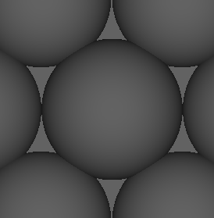
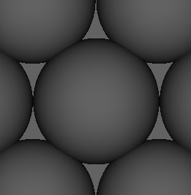
Theory – ambient occlusion
Ambient occlusion is the idea that a point will not receive as much ambient light if there are objects in close proximity to it.
It is used to simulate soft shadows that should occur due to indirect lighting.
Technically ambient occlusion should not occur at points in direct light, but since I don’t have indirect lighting I just apply it everywhere.

Slide 4
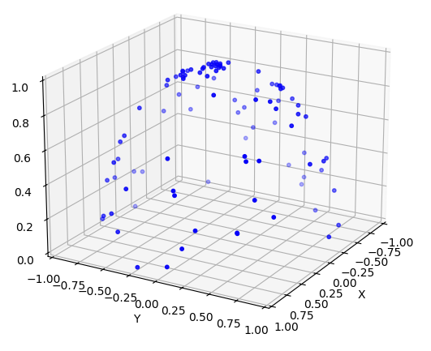
Theory – ambient occlusion
Generate samples in a hemisphere and invert any that are past 90 degrees from the normal we’re looking at (dot product less than 0).
If a sample hits then we are more occluded and less ambient light should reach this point. (No samples hit all ambient light added, all samples hit no ambient light added, half samples hit half ambient light added)

Slide 5
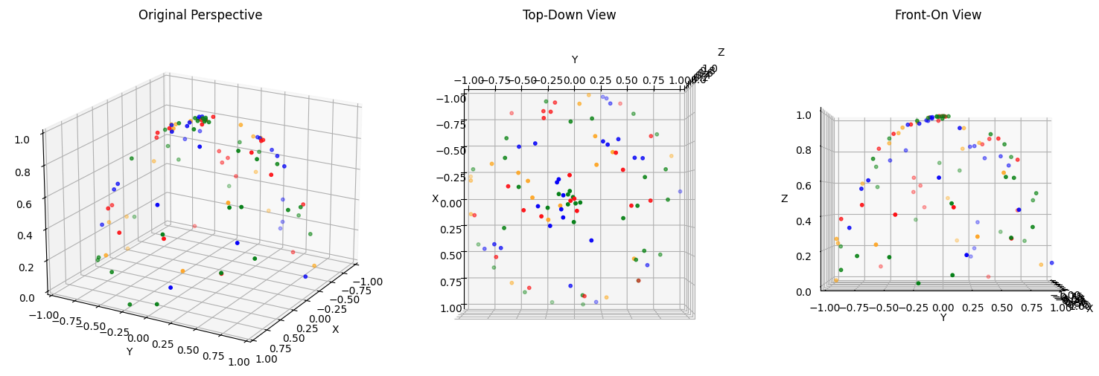
Theory – ambient occlusion
Optimised to split samples into smaller groups and test groups one by one. We exit early when no new samples hit something, assuming no ambient occlusion at this point. Avoids testing lots of samples unnecessarily.
Greatly increases performance in scenes where lots of points have no other object near so that point has no ambient occlusion.
Sample splitting creates false negative where we exit early assuming no ambient occlusion when if we tested more samples we’d find there is some.

Slide 6
Design
RayObject base class allows for easy creation of new shapes.
To create a new object you only need to write the code for the ray interception function and a normal at a given position function.

Slide 7
Analysis
All tests use 640 x 480 resolution.
Average frame time over 10 frames.
Core i7-13700 16 core CPU.

Slide 8
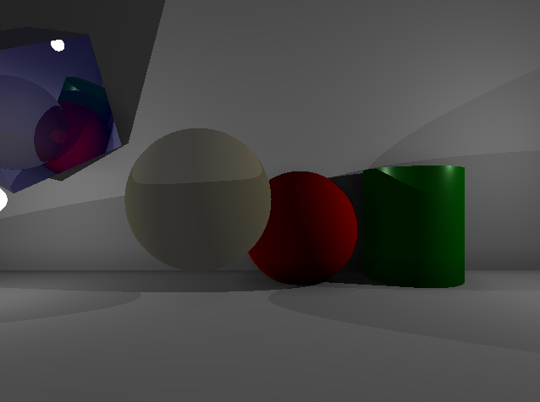
Analysis – test 1, threads
Using scene 1 with 64 ambient occlusion samples with a split of 1.
Tested 1 to 500 frames to see the difference in frame time.

Slide 9
Analysis – test 1, threads

Slide 10
Analysis – test 1, threads

Slide 11
Analysis – test 2, threads & tasks
Using scene 1 with 64 ambient occlusion samples with a split of 1.
Tested continuous number of tasks against set number of threads.

Slide 12
Analysis – test 2, threads & tasks

Slide 13
Analysis – test 2, threads & tasks

Slide 14
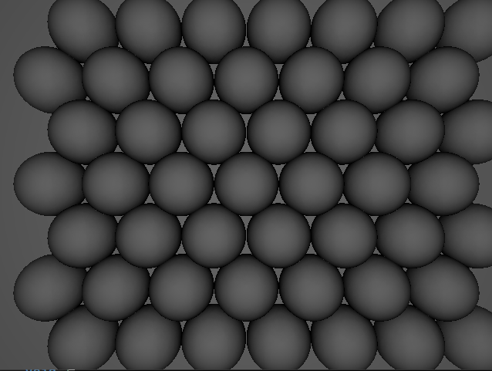
Analysis – test 3, ambient occlusion
Tested different ambient occlusion sample sizes, as well as different number of splits on scene 2 and then scene 1 to see the difference in frame time between differently split samples, and then see how the percentage change differs on a different scene.

Slide 15
Analysis – test 3, ambient occlusion

Slide 16
Analysis – test 3, ambient occlusion

Slide 17
Evaluation
Different ambient occlusion sample sizes, see lower resolution of ambient occlusion.
Same sample size different split sizes, see false negatives. Show frame time, may decide it’s worth it.
My scene with scene in blender.

Slide 18
References

Slide 19
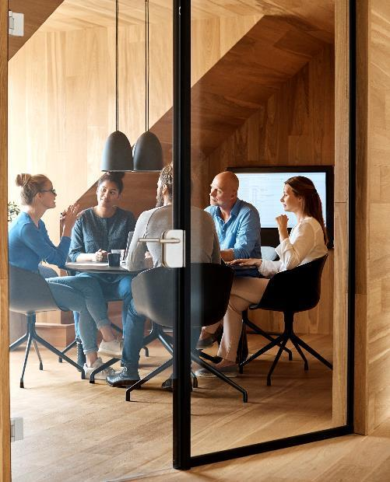



Introduction
With PowerPoint, you can create presentations and share your work with others, wherever they are. Type the text you want here to get started. You can also add images, art, and videos on this template. Save to OneDrive and access your presentations from your computer, tablet, or phone.

Slide 20

Topic one
Subtitle

Slide 21
Chart

Slide 22
Table
 | Category 1 | Category 2 | Category 3 | Category 4
Item 1 | 4.5 | 2.3 | 1.7 | 5
Item 2 | 3.2 | 5.1 | 4.4 | 3
Item 3 | 2.1 | 1.7 | 2.5 | 2.8
Item 4 | 4.5 | 2.2 | 1.7 | 7

Slide 23

The way to get started is to quit talking and begin doing.
Walt Disney

Slide 24




Team
Name
Name
Name
Name
Title
Title
Title
Title

Slide 25
Timeline
Title
To start a presentation, go to the Slide Show tab, and select From Beginning.
Title
To display Presenter view, in Slide Show view, on the control bar at the bottom left select the three dots, and then Show Presenter View.
Title
During your presentation, the speaker notes are visible on your monitor, but aren't visible to the audience.
Title
Title
If you can’t see the Notes pane or it is completely minimised, click Notes on the task bar across the bottom of the PowerPoint window.
The Notes pane is a box that appears below each slide. Tap it to add notes.

Slide 26
Content 2
Subtitle
subtitle
subtitle
Add text, images, art, and videos.
Add transitions, animations, and motion.
Save to OneDrive, to get to your presentations from your computer, tablet, or phone.
Open the Design Ideas pane for instant slide makeovers.
When we have design ideas, we’ll show them to you right there.
Add text, images, art, and videos.
Add transitions, animations, and motion.
Save to OneDrive, to get to your presentations from your computer, tablet, or phone.
Open the Design Ideas pane for instant slide makeovers.
When we have design ideas, we’ll show them to you right there.
Add text, images, art, and videos.
Add transitions, animations, and motion.
Save to OneDrive, to get to your presentations from your computer, tablet, or phone.
Open the Design Ideas pane for instant slide makeovers.
When we have design ideas, we’ll show them to you right there.

Slide 27

Summary
With PowerPoint, you can create presentations and share your work with others, wherever they are. Type the text you want here to get started. You can also add images, art, and videos on this template. Save to OneDrive and access your presentations from your computer, tablet, or phone.

Slide 28


Thank You
Presenter name
Email address
Website address

